Slide 1
Proyecto ARM
...
{
< Santiago Barrios- 1900 3827 > < Andoni Carrillo – 2000 8479 >
< Jonathan Cojom – 1900 0710 >
}

Slide 2
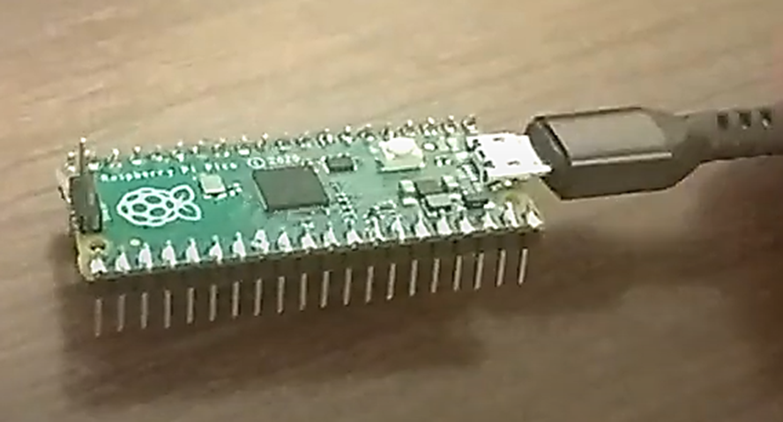
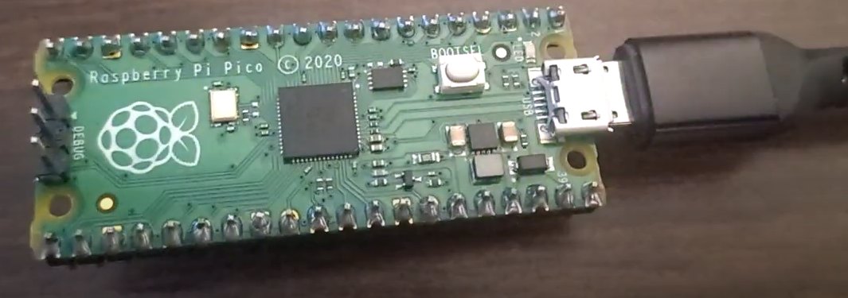
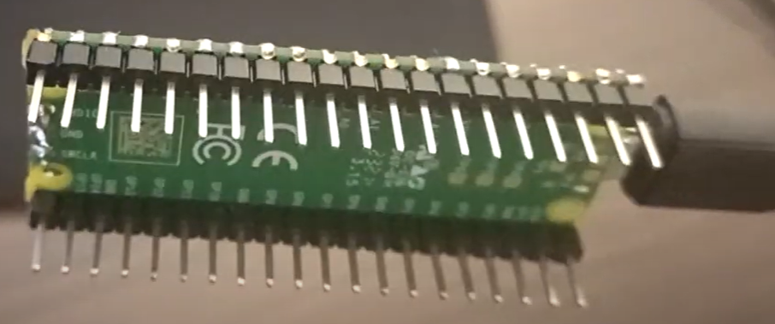
Proceso de ensamblaje y soldadura de las placas
{
}
...

Slide 3
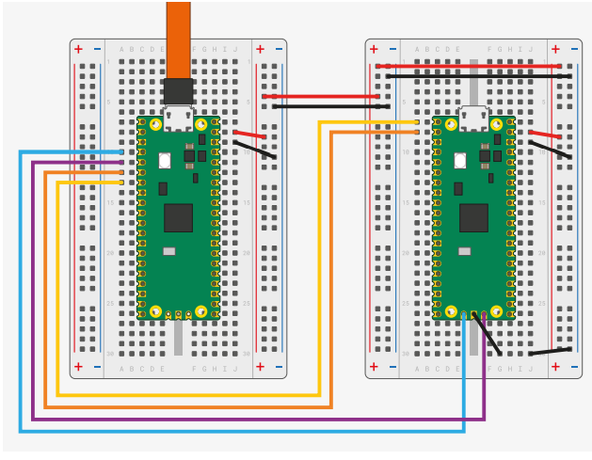
Diagrama de conexión de las placas
{
}
...

Slide 4
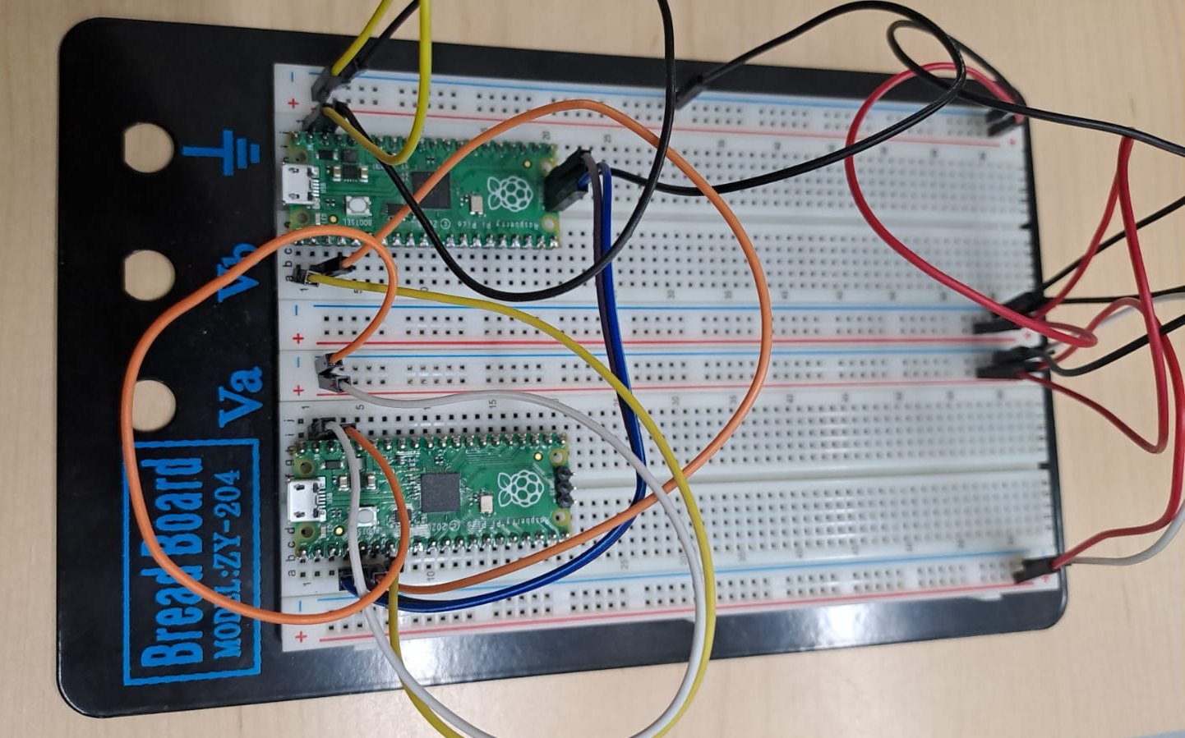
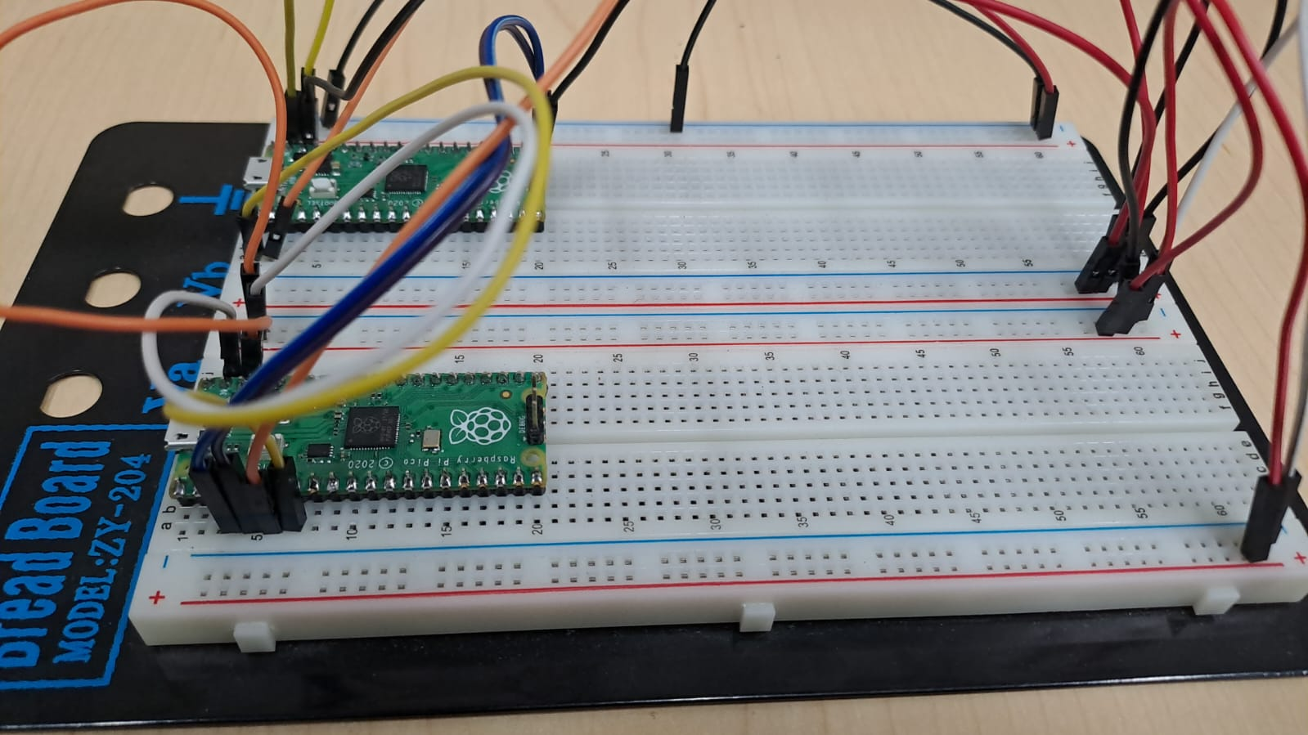
Resultado de las Conexiones
{
...
}

Slide 5
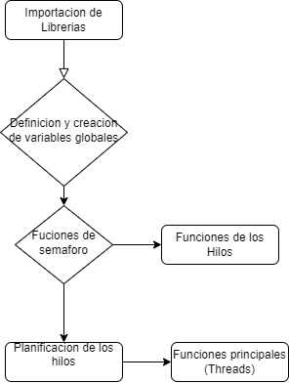
Estructura del codigo
{
...
}

Slide 6
Tabla de Contenido
01
02
03
Manejo de Threads
Context Switching
Implementación de Semáforos
Notes:
5. Thread States: The code defines an enumeration ThreadState to represent the states of a thread (THREAD_RUNNING, THREAD_SUSPENDED, THREAD_TERMINATED). The thread functions (thread1_func and thread2_func) check the state of the current thread before executing their code. The code also prints the state of the thread before and after acquiring/releasing the semaphore, allowing observation and verification of the thread states.
6. Initialization and Termination: The init_threads function initializes the thread control blocks with the required information for each thread. The code handles the termination of threads by checking the thread state and either continuing to the next iteration or printing a termination message.

Slide 7
Tabla de Contenido
04
05
06
Timer Interrupt
Estados de los Threads
Llamadas a Threads
Notes:
What aspects are we covering in this example of an RTOS
1. Thread Management: The code defines a structure called ThreadControlBlock to store information about each thread, including the thread function, priority, remaining time, thread ID, waiting state, and state. The code initializes and manages two threads (thread1_func and thread2_func). The current_thread variable keeps track of the currently executing thread. The kernel_thread_scheduler function implements the thread scheduling algorithm based on thread priorities and states.
2. Context Switching: The code includes a yield function that performs a context switch to the next thread. Context switching allows different threads to execute in a cooperative manner, ensuring fairness and giving each thread a chance to run.
3. Semaphore Implementation: The code defines a Semaphore structure and provides functions (semaphore_init, semaphore_acquire, semaphore_release) to initialize, acquire, and release a semaphore. Semaphores are used to control access to shared resources, in this case, the LED. The code demonstrates the correct usage of semaphores by acquiring and releasing the semaphore before and after accessing the LED.
4. Timer Interrupt: The code sets up a timer interrupt (kernel_tick_handler) that triggers periodically. This interrupt is used for the RTOS kernel tick, which is responsible for managing the execution time of threads and resetting their remaining time. The interrupt handler iterates through the thread control blocks and updates the remaining time of each thread based on its priority.
5. Thread States: The code defines an enumeration ThreadState to represent the states of a thread (THREAD_RUNNING, THREAD_SUSPENDED, THREAD_TERMINATED). The thread functions (thread1_func and thread2_func) check the state of the current thread before executing their code. The code also prints the state of the thread before and after acquiring/releasing the semaphore, allowing observation and verification of the thread states.
6. Initialization and Termination: The init_threads function initializes the thread control blocks with the required information for each thread. The code handles the termination of threads by checking the thread state and either continuing to the next iteration or printing a termination message.

Slide 8
01
Manejo de Threads
{
..
}
..

Slide 9
01 Manejo de Threads
Para el manejo de los threads se definió una estructura ‘ThreadControlBlock’ la cual almacena información de los {Threads}
Función
ID,prioridad
Estado, estado de espera, tiempo restante
Se inicia manejando dos threads
El thread actual (current_thread) lleva control del thread en ejecución
{scheduler} es el calendarizador que trabaja con las prioridades y estados
}
..
Notes:
1. Thread Management: The code defines a structure called ThreadControlBlock to store information about each thread,
including the thread function, priority, remaining time, thread ID, waiting state, and state.
The code initializes and manages two threads (thread1_func and thread2_func).
The current_thread variable keeps track of the currently executing thread.
The kernel_thread_scheduler function implements the thread scheduling algorithm based on thread priorities and states.

Slide 10
02
Context Switching
{
..
}
..

Slide 11
02 Context Switching
En la sección de código donde se maneja el {context switching} se implementó una función ‘yield’ que se encarga de realizar el context switch hacia el siguiente thread.
}
..
Notes:
2. Context Switching: The code includes a yield function that performs a context switch to the next thread.
Context switching allows different threads to execute in a cooperative manner, ensuring fairness and giving each thread a chance to run.

Slide 12
03
Implementación de Semáforos
{
..
}
..

Slide 13
03 Implementación de Semáforos
En esta parte se implementó lo siguiente:
Una estructura para los semáforos.
Las funciones:
semaphore_init()
semaphore_acquire()
semaphore_release()
Recordemos que los semáforos son usados para controlar el acceso a recursos compartidos, en nuestro caso el LED.
}
..
Notes:
3. Semaphore Implementation: The code defines a Semaphore structure and provides functions (semaphore_init, semaphore_acquire, semaphore_release) to initialize, acquire, and release a semaphore.
Semaphores are used to control access to shared resources, in this case, the LED.
The code demonstrates the correct usage of semaphores by acquiring and releasing the semaphore before and after accessing the LED.

Slide 14
04
Timer Interrupt
{
..
}
..

Slide 15
04 Timer Interrupt
En la sección del {timer interrupt} se activa periódicamente y se setea en la función ‘tick_handler’.
El manejo de este control de tiempo es el responsable de llevar el tiempo de ejecución de los threads y resetear su tiempo restante.
El interrupt handler aquí itera a través del {thread_control_block} y actualiza el tiempo restante de ejecución de cada thread basándose en la prioridad de cada uno.
}
..
Notes:
4. Timer Interrupt: The code sets up a timer interrupt (kernel_tick_handler) that triggers periodically.
This interrupt is used for the RTOS kernel tick, which is responsible for managing the execution time of threads and resetting their remaining time.
The interrupt handler iterates through the thread control blocks and updates the remaining time of each thread based on its priority.

Slide 16
05
Estados de los Threads
{
..
}
..

Slide 17
05 Estados de los Threads
Se creó una ¨Enum¨ (ThreadState) para representar los estados de los threads:
THREAD_RUNNING
THREAD_SUSPENDED
THREAD_TERMINATED
Las funciones de los threads (thread1_func & thread2_func) verifican el estado del thread actual antes de ejecutar el código.
El código también imprime el estado actual de los threads antes y después de hacer acquirer/release del semáforo.
}
..

Slide 18
06
Llamadas a Threads
{
..
}
..

Slide 19
06 Llamadas a Threads
Declaramos una función init_threads la cual se inicializa el thread control block con la información requerida de cada thread.
El código maneja la finalización de los threads chequeando su estado, si no ha finalizado continúa en la iteración, si el thread está en estado de finalizado se imprime un mensaje de finalización.
}
..
Notes:
6. Initialization and Termination: The init_threads function initializes the thread control blocks with the required information for each thread. The code handles the termination of threads by checking the thread state and either continuing to the next iteration or printing a termination message.

Slide 20
Gracias
{
..
}
..

